Slide 1
Evolution of IT Infrastructure
Raghu

Slide 2
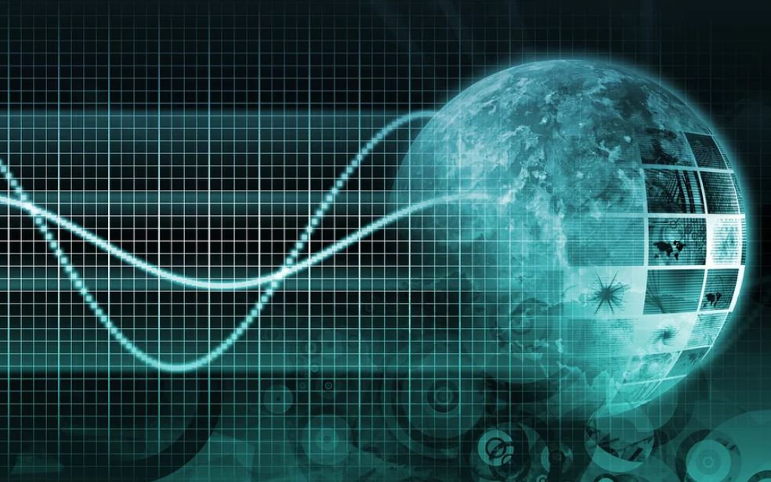
What is information technology?

Slide 3
It’s just computers?
Well, yes, it is computers
Serves as a valuable definition

Slide 4
What is IT ?
spectrum of technologies
including
software, hardware, communications technologies, and related services
used to
create, process, store, secure, and exchange data.

Slide 5
Modern-day spectrum
Modern IT is the result of nearly six decades of consistent and impactful innovation
We need to track its evolution to understand where it’s come from, where it’s at, and where it’s going.

Slide 6
What Is Information Technology? The 5 Evolutionary Stages of Modern IT

Slide 7
Five key stages
The Centralized Mainframe
Personal Computing
Client/Server era
Enterprise Computing
The Cloud

Slide 8
What is next ?
A new computing revolution underway with advances in quantum computing opening up new possibilities for the progression of IT.
While technologies that currently run on classical computers can help find patterns and insights that may be buried in vast amounts of existing data, quantum computers are capable of delivering solutions to important problems where patterns cannot be seen, because the data doesn’t exist and the possibilities that you need to explore to get to the answers are simply too big to ever be processed by classical computers.
Eg: IBMQ

Slide 9
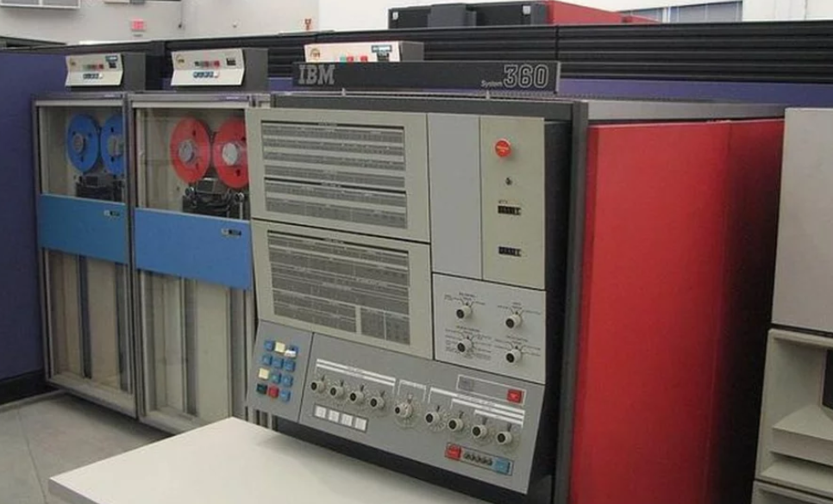
Mainframes
Launched in 1964, the IBM 360 is widely recognized as the world’s first modern mainframe

Slide 10
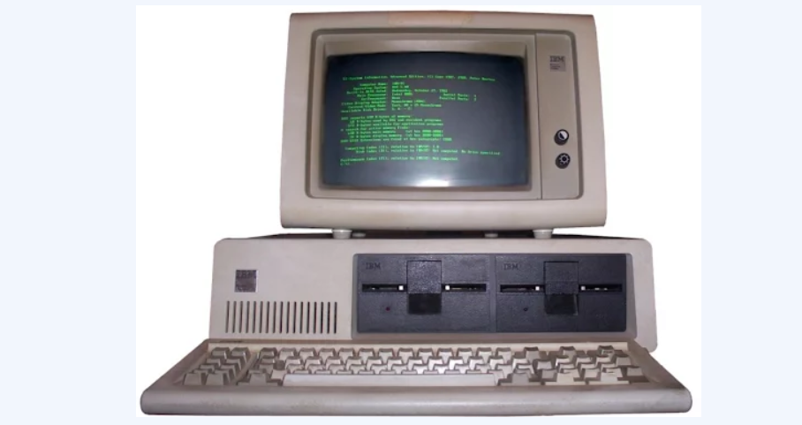
Personal Computing
In 1975 first genuinely affordable personal computer emerged in the form of the Altair 8800
The 70s also saw the launch of the Apple I and II, but access was still predominantly restricted to the technologists.
In the early days, most of these PCs, even in the enterprise environment, were used as standalone desktop systems with no connectivity whatsoever due to the lack of requisite hardware and software for networking. That would not change until the 90s and the arrival of the internet.
IBM PC in 1981

Slide 11
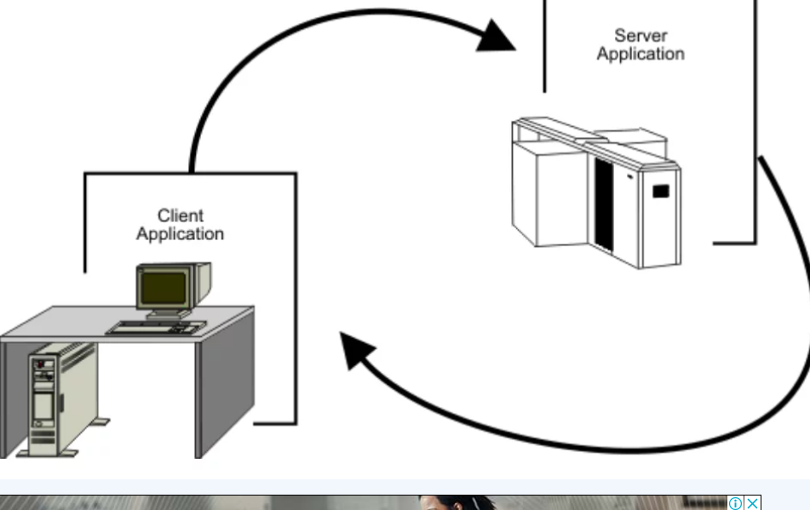
Client-server and Enterprise Computing Eras

Slide 12
Client/Server
By the 80s, there was an increasing need for businesses to connect all their standalone PCs so that employees could collaborate and share resources.
Local Area Network (LAN)
The server could be a mainframe or a powerful configuration of smaller inexpensive systems that offer the same performance and functionality of a mainframe at a fraction of the cost.

Slide 13
In 1990s
In the 1990s, the client-server approach spilled over into the enterprise computing era, driven by the need to integrate disparate networks and applications into a unified enterprise-wide infrastructure.

Slide 14
Enterprise IT with Cloud Computing
In 1999, Salesforce launched an enterprise-level customer relationship management (CRM) application over the internet as an alternative for traditional desktop software.
The term cloud computing was yet to enter the technological lexicon.
Three years later, Amazon would join the race by offering computational and storage solutions over the internet.
These two events foreshadowed a transformative and disruptive trend in information technology wherein the core emphasis for enterprise IT would shift from hardware to software.

Slide 15
Research
According to Gartner, enterprise information technology spending on cloud-based offerings will significantly outpace that of non-cloud offerings at least until 2022

Slide 16
Cloud computing offerings
Cloud computing gives enterprise information technology on-demand access to computing resources, including networks, servers, storage, applications, and services, without the cost or hassle of managing and maintaining all that hardware.
Pay as u go
Scaleup and down and Scale out & in.
Cloud is not just a cost-centric alternative for on-premise systems
It is a critical driver for innovation, eg: AI/ML etc.

Slide 17
Final Thoughts on evolution.
What is information technology?
It is an ongoing evolution of hardware, software, storage, networking, infrastructure, and processes to create, process, store, secure, and exchange all forms of electronic data in increasingly innovative ways.
Information technology in modern times has been evolving at an increasingly blistering place over the past few decades.
Source: Internet & articles

